Slide 1
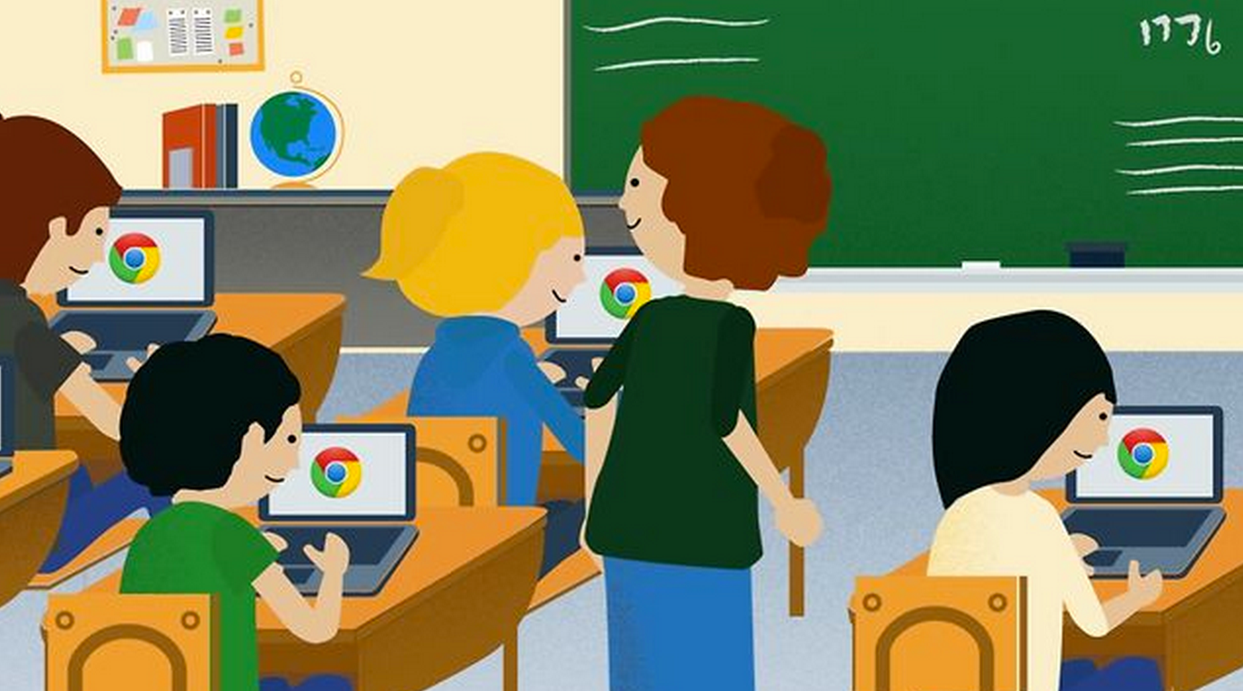
Learning about your Chromebook
Notes:
slides 2-9 about 10 minutes
We have been implementing chromebooks in our schools to provide technology access for students -
---How many of you have children who are using chromebooks or ipads in school?
Respond according the responses you receive.

Slide 2
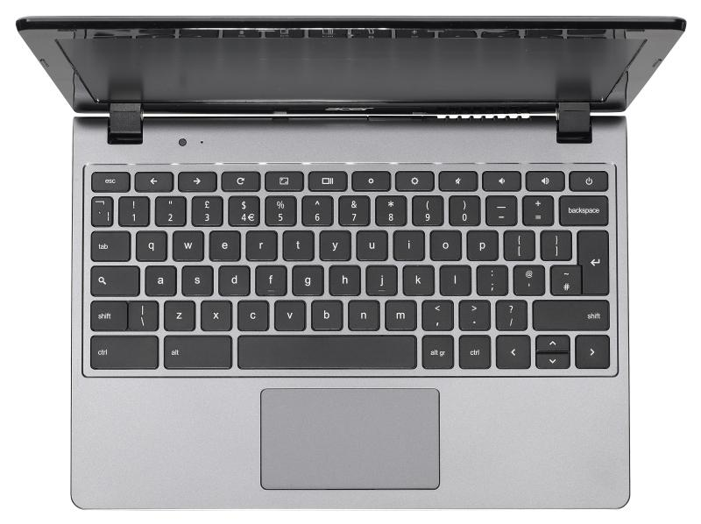
The Chromebook
The Chromebook looks and feels slightly different from a laptop or tablet.
Notes:
Let’s start with the basics - to get familiar with the chromebook - look at the next few slides and then we will practice.

Slide 3
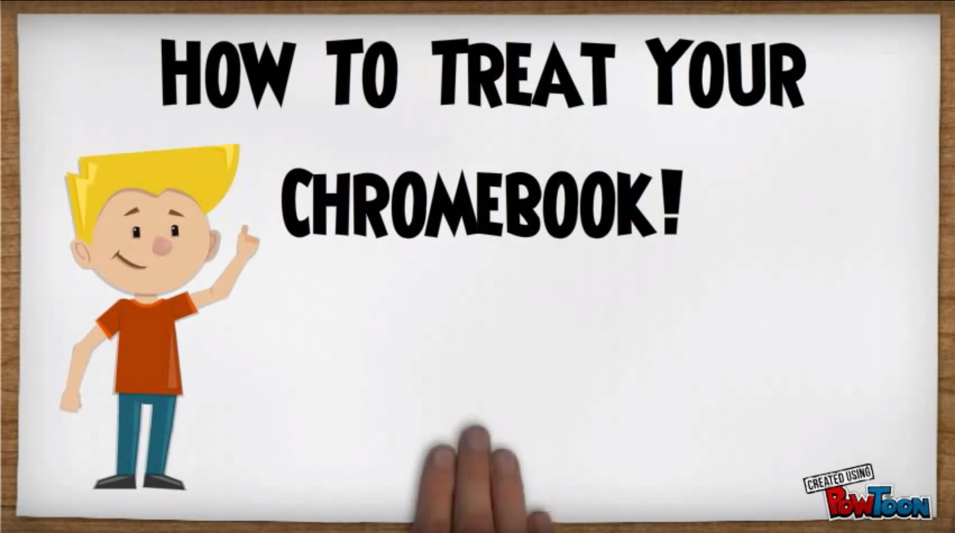
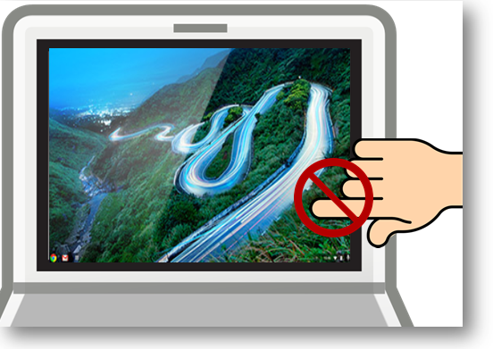
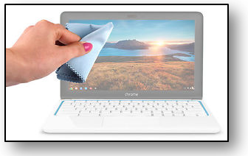
Chromebook General Care
How To Treat Your Chromebook!
Do not allow food or drinks near the Chromebook.
Do not touch the Chromebook screen. Clean the keys and screen with a lightly moistened (water only) soft cloth.
video- http://goo.gl/bAoxAd
Notes:
Play the video by clicking on “How to Treat Your Chromebook! is a hyperlink to a video (1:29 minutes)
tips for general care of your chromebook…”

Slide 4
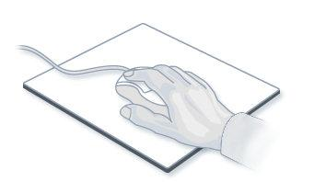
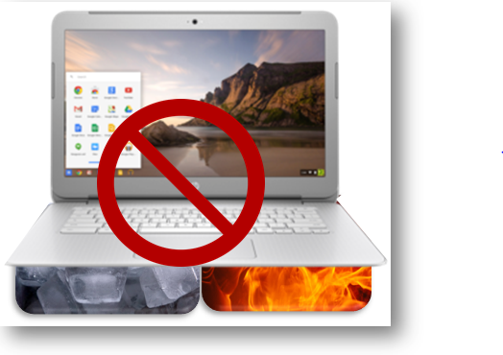
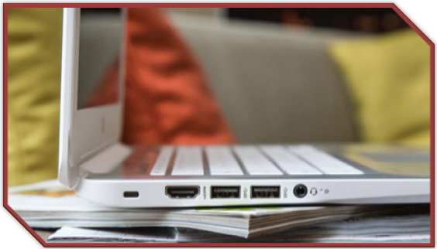
Chromebook General Care
Make sure your mouse is resting on a flat surface clear of obstacles. Is the mouse pad necessary?
Chromebooks do not like excessive heat or cold.
Do not place your Chromebook on uneven surfaces

Slide 5
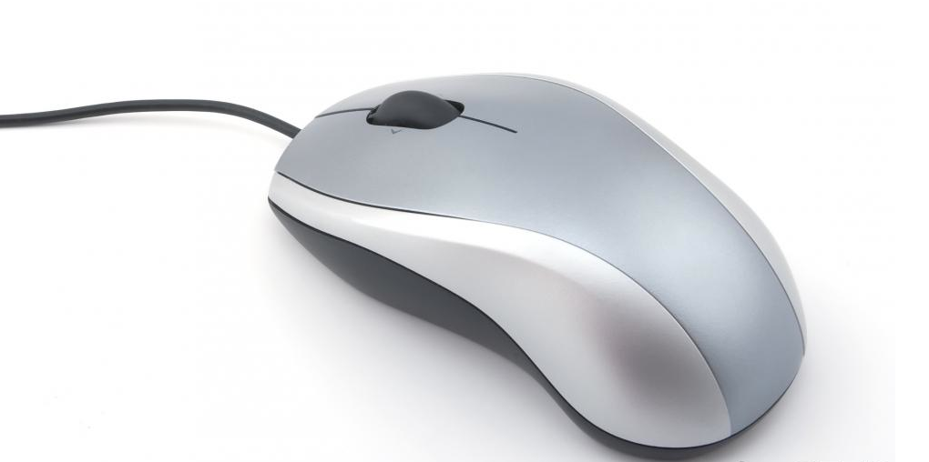
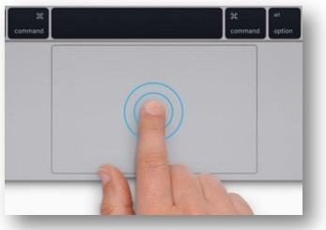
Moving Around on the Chromebook
or touchpad
mouse
Notes:
When you move the cursor over a link it will likely change from an arrow to a hand. (But not always!)

Slide 6
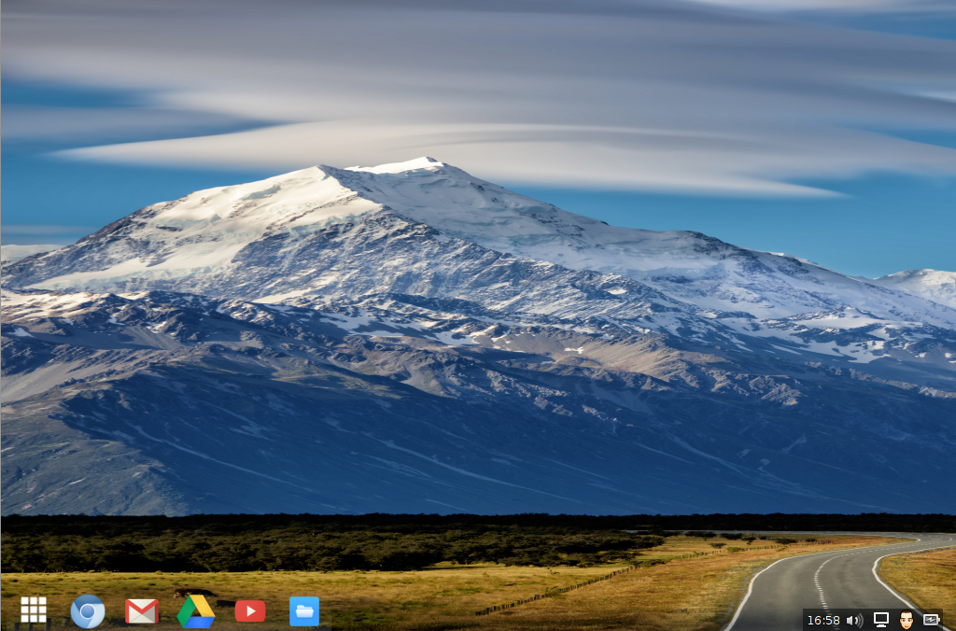
Arrow or Hand
The mouse or touchpad controls the cursor which you see as either an arrow you move around the page or a hand to select an option and/or link.
Notes:
The cursor will look like an arrow as it is moved around the screen.
When there is an active link the arrow turns to a hand.

Slide 7
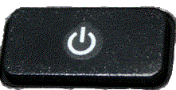
Your Chromebook Keyboard
Refresh key --top row of the keyboard
Brightness controls --top row of the keyboard
Sound keys --top row of the keyboard
No caps lock
No Delete key -- use backspace instead
On/Off
Refresh key
Dim the screen
Make the screen brighter
Mute
Lower the volume
Raise the volume
Search Key
backspace
spacebar
Notes:
Top Keys
Left Arrow - Go to the previous page in your browser history
Reight Arrow - Go to the next page in your browser history
Circle Arrow - Reload your current page
Square w/out pointers - Hide the tabs and launcher in full-screen Immersive mode
Square and two lines - Show all windows in Overview mode
Small circle - Dim the screen
Larger circle - Make the screen brighter
Volume X - Mute
Volume --Lower the volume
Volume +Raise the volume

Slide 8
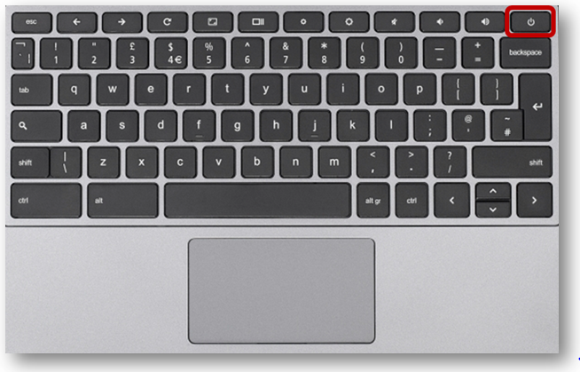
Turning the Chromebook on & off
The on/off button is on the keyboard. Usually the top right
To turn on your Chromebook press the power button for about four seconds. The screen will power on.
To turn off your Chromebook press the power button for about four seconds. The screen will go dark.
Or simply close the lid for sleep mode.
Notes:
Let’s start with the basics - to get familiar with the chromebook - lets look at the next few slides and then we will practice.

Slide 9
Notes:
End of class 1. Ask if there are any questions or comments.

